Slide 1
Job Posting Analysis
Adam Sampson
Jack Letcher
Taylor Maxson
Nathan Thomas

Slide 2

https://www.bing.com/images/search?view=detailV2&ccid=Y9XgRZ8V&id=1E283B45F3583F02D5E895D7A5073722633532B6&thid=OIP.Y9XgRZ8VMJhjgsew2AF2ogEsDH&mediaurl=http%3a%2f%2fimages.techhive.com%2fimages%2farticle%2f2016%2f03%2fcorrelation-one-100653446-primary.idge.jpg&exph=413&expw=620&q=data+scientist+jobs&simid=608030408846868974&selectedIndex=2&ajaxhist=0

Slide 3
Overview
Business Purpose
Data Exploration
Identifying the different types of information in the text
Data Preparation
Separate preparation for each type of model
Modeling
Topic modeling
k-Means Clustering
Tf-idf ranking
Jaccard similarity ranking
Evaluation

Slide 4

Business Understanding
Define a question and an approach
Image by Kenneth Jensen [CC BY-SA 3.0 (https://creativecommons.org/licenses/by-sa/3.0)], via Wikimedia Commons

Slide 5
Business Purpose
Problem: Job Applicants, HR departments, and Headhunter Firms have to hunt through a large number of job postings and resumes trying to match candidates to jobs.
Basic job searches online may only include a handful of words.
HR or Headhunters may be able to search resume’s by keywords to check for mandatory values, but this only gives knowledge of whether a candidate has some or all of the required/desired items in their resume

Slide 6
Business Purpose Cont’d
Headhunter firms have a goal of finding candidates that will be qualified for jobs while wasting as little time as possible.
Rank potential candidates by how close they match jobs
Start with best candidates
Eliminate definite misses
Be prepared to cold-call candidates even for jobs a candidate may not be considering
Identify weaknesses in a candidate’s resume to increase odds of successful placement at a company (and commission)

Slide 7
Solution to Business Problem
Score resume match to job posting
1
List missing items in resume for job postings
2
Identify similar jobs to increase odds of matching candidate to some job
3

Slide 8
Data Understanding
Define a question and an approach
Image by Kenneth Jensen [CC BY-SA 3.0 (https://creativecommons.org/licenses/by-sa/3.0)], via Wikimedia Commons

Slide 9
Data Exploration
Job Posting
Resume
Webscraped in <XML> format
Sectioned by company
Job ID
Job Title
Job Description
Many documents available
Non-uniform
Mix of narrative, lists, matrixes, etc.
Limited documents available

Slide 10
Data Preparation

Slide 13
Model: k-Means Clustering
Objective – to determine which jobs were most similar and group them.
Desired output -

Slide 14
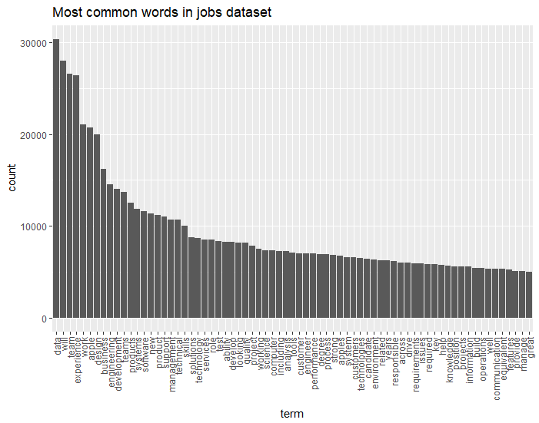
Most Frequent Terms
Top Terms:
Data
Will
Team
Experience
Work
Apple
Design
Business
Engineering
Development

Slide 15

Visual of the top terms

Slide 16
LDA – Topic Modeling
Input Jobs Document Term Matrix (DTM)
LDA with k = 5
jobs.k5.lda <- LDA(jobs.dtm,k=5)
LDA with k = 50
jobs.k5.lda <- LDA(jobs.dtm,k=50)

Slide 17
LDA Resume Categorization (k = 5)
 | Topic 1 | Topic 2 | Topic 3 | Topic 4 | Topic 5 | Row Sum
Jack | 0.518 | 0.021 | 0.021 | 0.058 | 0.383 | 1.000
Nathan | 0.632 | 0.034 | 0.024 | 0.049 | 0.262 | 1.000
Adam | 0.253 | 0.319 | 0.032 | 0.041 | 0.355 | 1.000
Sample_Art | 0.209 | 0.063 | 0.071 | 0.200 | 0.458 | 1.000
Sample_Housekeeper | 0.461 | 0.114 | 0.084 | 0.067 | 0.274 | 1.000
Sample_Sales | 0.507 | 0.000 | 0.030 | 0.026 | 0.437 | 1.000
resume.topics <- topicmodels::posterior(jobs.lda,newdata = resume.dtm)

Slide 18
LDA Top Terms by Topic (k = 5)
Topic 1 | Topic 2 | Topic 3 | Topic 4 | Topic 5
business | design | technical | team | business
management | test | customers | software | security
project | engineering | home | systems | information
support | development | hours | computer | analytics
team | team | ability | science | team
process | product | well | engineering | solutions
operations | system | training | services | services
ability | quality | advisor | design | product
manage | new | world | products | analysis
skills | develop | support | new | technical

Slide 19
LDA Resume Categorization (k = 50)
 | Topic 3 | Topic 9 | Topic 46 | Topic 37 | Topic 12 | Row Sum
Jack | 0.28473 | 0.18874 | 0.15367 | 0.07335 | 0.03094 | 0.73141
Nathan | 0.21717 | 0.12246 | 0.26020 | 0.09329 | 0.00807 | 0.70119
Adam | 0.16356 | 0.00008 | 0.10437 | 0.04101 | 0.00008 | 0.30910
Sample_Art | 0.25096 | 0.00009 | 0.08979 | 0.04257 | 0.08727 | 0.47068
Sample_Housekeeper | 0.09274 | 0.05279 | 0.34383 | 0.00009 | 0.06326 | 0.55272
Sample_Sales | 0.22208 | 0.06926 | 0.16075 | 0.00008 | 0.01381 | 0.46598
resume.topics <- topicmodels::posterior(jobs.lda,newdata = resume.dtm)

Slide 20
LDA Top Terms by Topic (k = 50)
Topic 3 | Topic 9 | Topic 46 | Topic 37 | Topic 12
data | business | care | finance | data
business | finance | health | team | status
information | operations | role | customers | protected
years | accounting | skills | shipping | cloud
management | support | home | products | disability
technology | forecast | members | support | medical
time | analyst | healthcare | organization | team
sql | analysis | knowledge | integrity | customers
full | new | patient | share | services
solutions | management | clinical | positive | azure

Slide 21
Evaluation

Slide 23
Next Steps…

